Slide 1
Section 4: California and Utah
The American Journey Pages 378-382

Slide 2
Essential Question
What factors affected the settlement of California and Utah in the West?

Slide 3
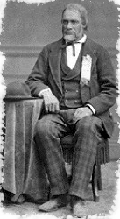
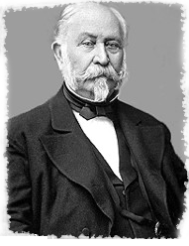
Sutter’s Sawmill
Marshall and Sutter operated a mill
Marshall discovered gold
James W. Marshall
John A. Sutter
Single click speaker to hear audio clip >>>>
Notes:
In 1848, James W. Marshall and John A. Sutter, two businessmen operating a mill in California, made a startling discovery. While on the job at his sawmill, Marshall discovered gold in the channel below. Listen to this clip to learn more about the gold discovery.

Slide 4
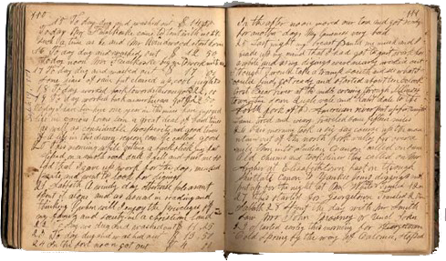
John Sutter’s Diary
John Sutter describes his reaction to the gold discovery
Notes:
John Sutter describes his reaction to his partner’s gold discovery: “It was a rainy afternoon when Mr. Marshall arrived at my office in the Fort, very wet. I was somewhat surprised to see him, as he was down a few days previous; and then, I sent up to Coloma a number of teams with provisions, mill irons, etc. He told me then that he had some important and interesting news which he wished to communicate secretly to me, and wished me to go with him to a place where we should not be disturbed, and where no listeners could come and hear what we had to say. I went with him to my private rooms; he requested me to lock the door; I complied, but I told him at the same time that nobody was in the house except the clerk, who was in his office in a different part of the house; after requesting of me something which he wanted, which my servants brought and then left the room, I forgot to lock the doors, and it happened that the door was opened by the clerk just at the moment when Marshall took a rag from his pocket, showing me the yellow metal.”

Slide 5
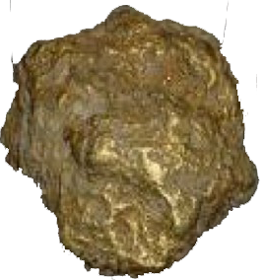
Their Little Secret
Keep the gold a secret
Fear of chaos
Thousands of people would flock to San Francisco
Notes:
Marshall and Sutter wanted to keep their discovery of gold a secret. They feared that if it became known that there was gold to be found in the area, chaos would break loose. Thousands of people would flock to San Francisco in search of riches—disrupting their plans to develop ranches, mills, and other enterprises in the area.

Slide 6
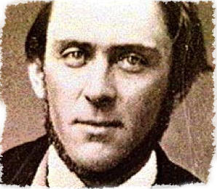
Someone Let It Slip…
Sam Brannan takes advantage
First gold rush millionaire
Notes:
Somehow word of gold in California got out. (Nobody knows if the clerk mentioned in Sutter’s diary was responsible or not.) Sam Brannan, a clever opportunist, became a very wealthy man during the ensuing gold rush and he didn’t find any gold. Brannan bought up all of the mining equipment in San Francisco and then ran through the streets of town with a jar full of gold dust, shouting “Gold! Gold from the American river!” Brannan became the gold rush’s first millionaire by selling mining supplies to prospectors.

Slide 7
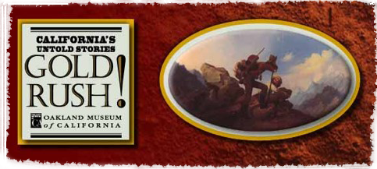
The Big Rush!
In 1849, world rushes to California
80,000 – 300,000 individuals
Notes:
In 1849, California experienced a “rush” of prospectors in search of gold. Nobody knows exactly how many people went to California during this time, but estimates range from 80,000 to 300,000 individuals.

Slide 8
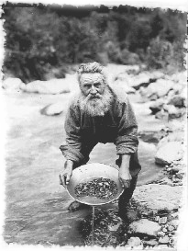
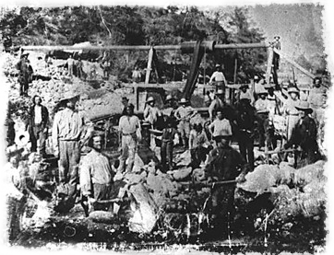
Forty-Niners
Gold seekers known as “forty-niners”
Migrated to California from all over the world
Found gold worth billions
Notes:
Gold seekers that went to California in the summer of 1849 became collectively known as “forty-niners.” They migrated to California from all over the world—from places as diverse as Latin America, Europe, Australia, and Asia—bringing a multicultural flavor to California. The massive amount of gold discovered during this time is worth billions in today’s U.S. dollars.

Slide 9
Results of the Gold Rush
Increase in populations leads to need for more effective government.
Californians wrote a constitution.
Notes:
Gold seekers that went to California in the summer of 1849 became collectively known as “forty-niners.” They migrated to California from all over the world—from places as diverse as Latin America, Europe, Australia, and Asia—bringing a multicultural flavor to California. The massive amount of gold discovered during this time is worth billions in today’s U.S. dollars.

Slide 10
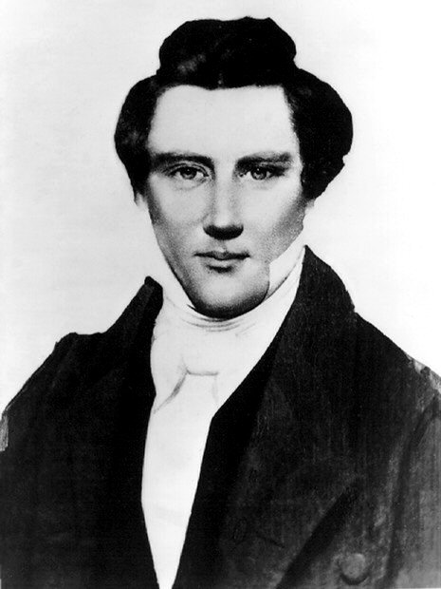
Utah and the Mormons
Church of Jesus Christ of Latter-Day Saints
Founded by Joseph Smith in 1830
Published Book of Mormon
Property held in common
Polygamy
Move from New York to Illinois
Smith killed by a mob
Notes:
Book of Mormon—Smith said it was the translation of words written on golden plates he had received from an angel.
The continued story of Jesus visiting the Native Americans in the New World after his resurrection.

Slide 11
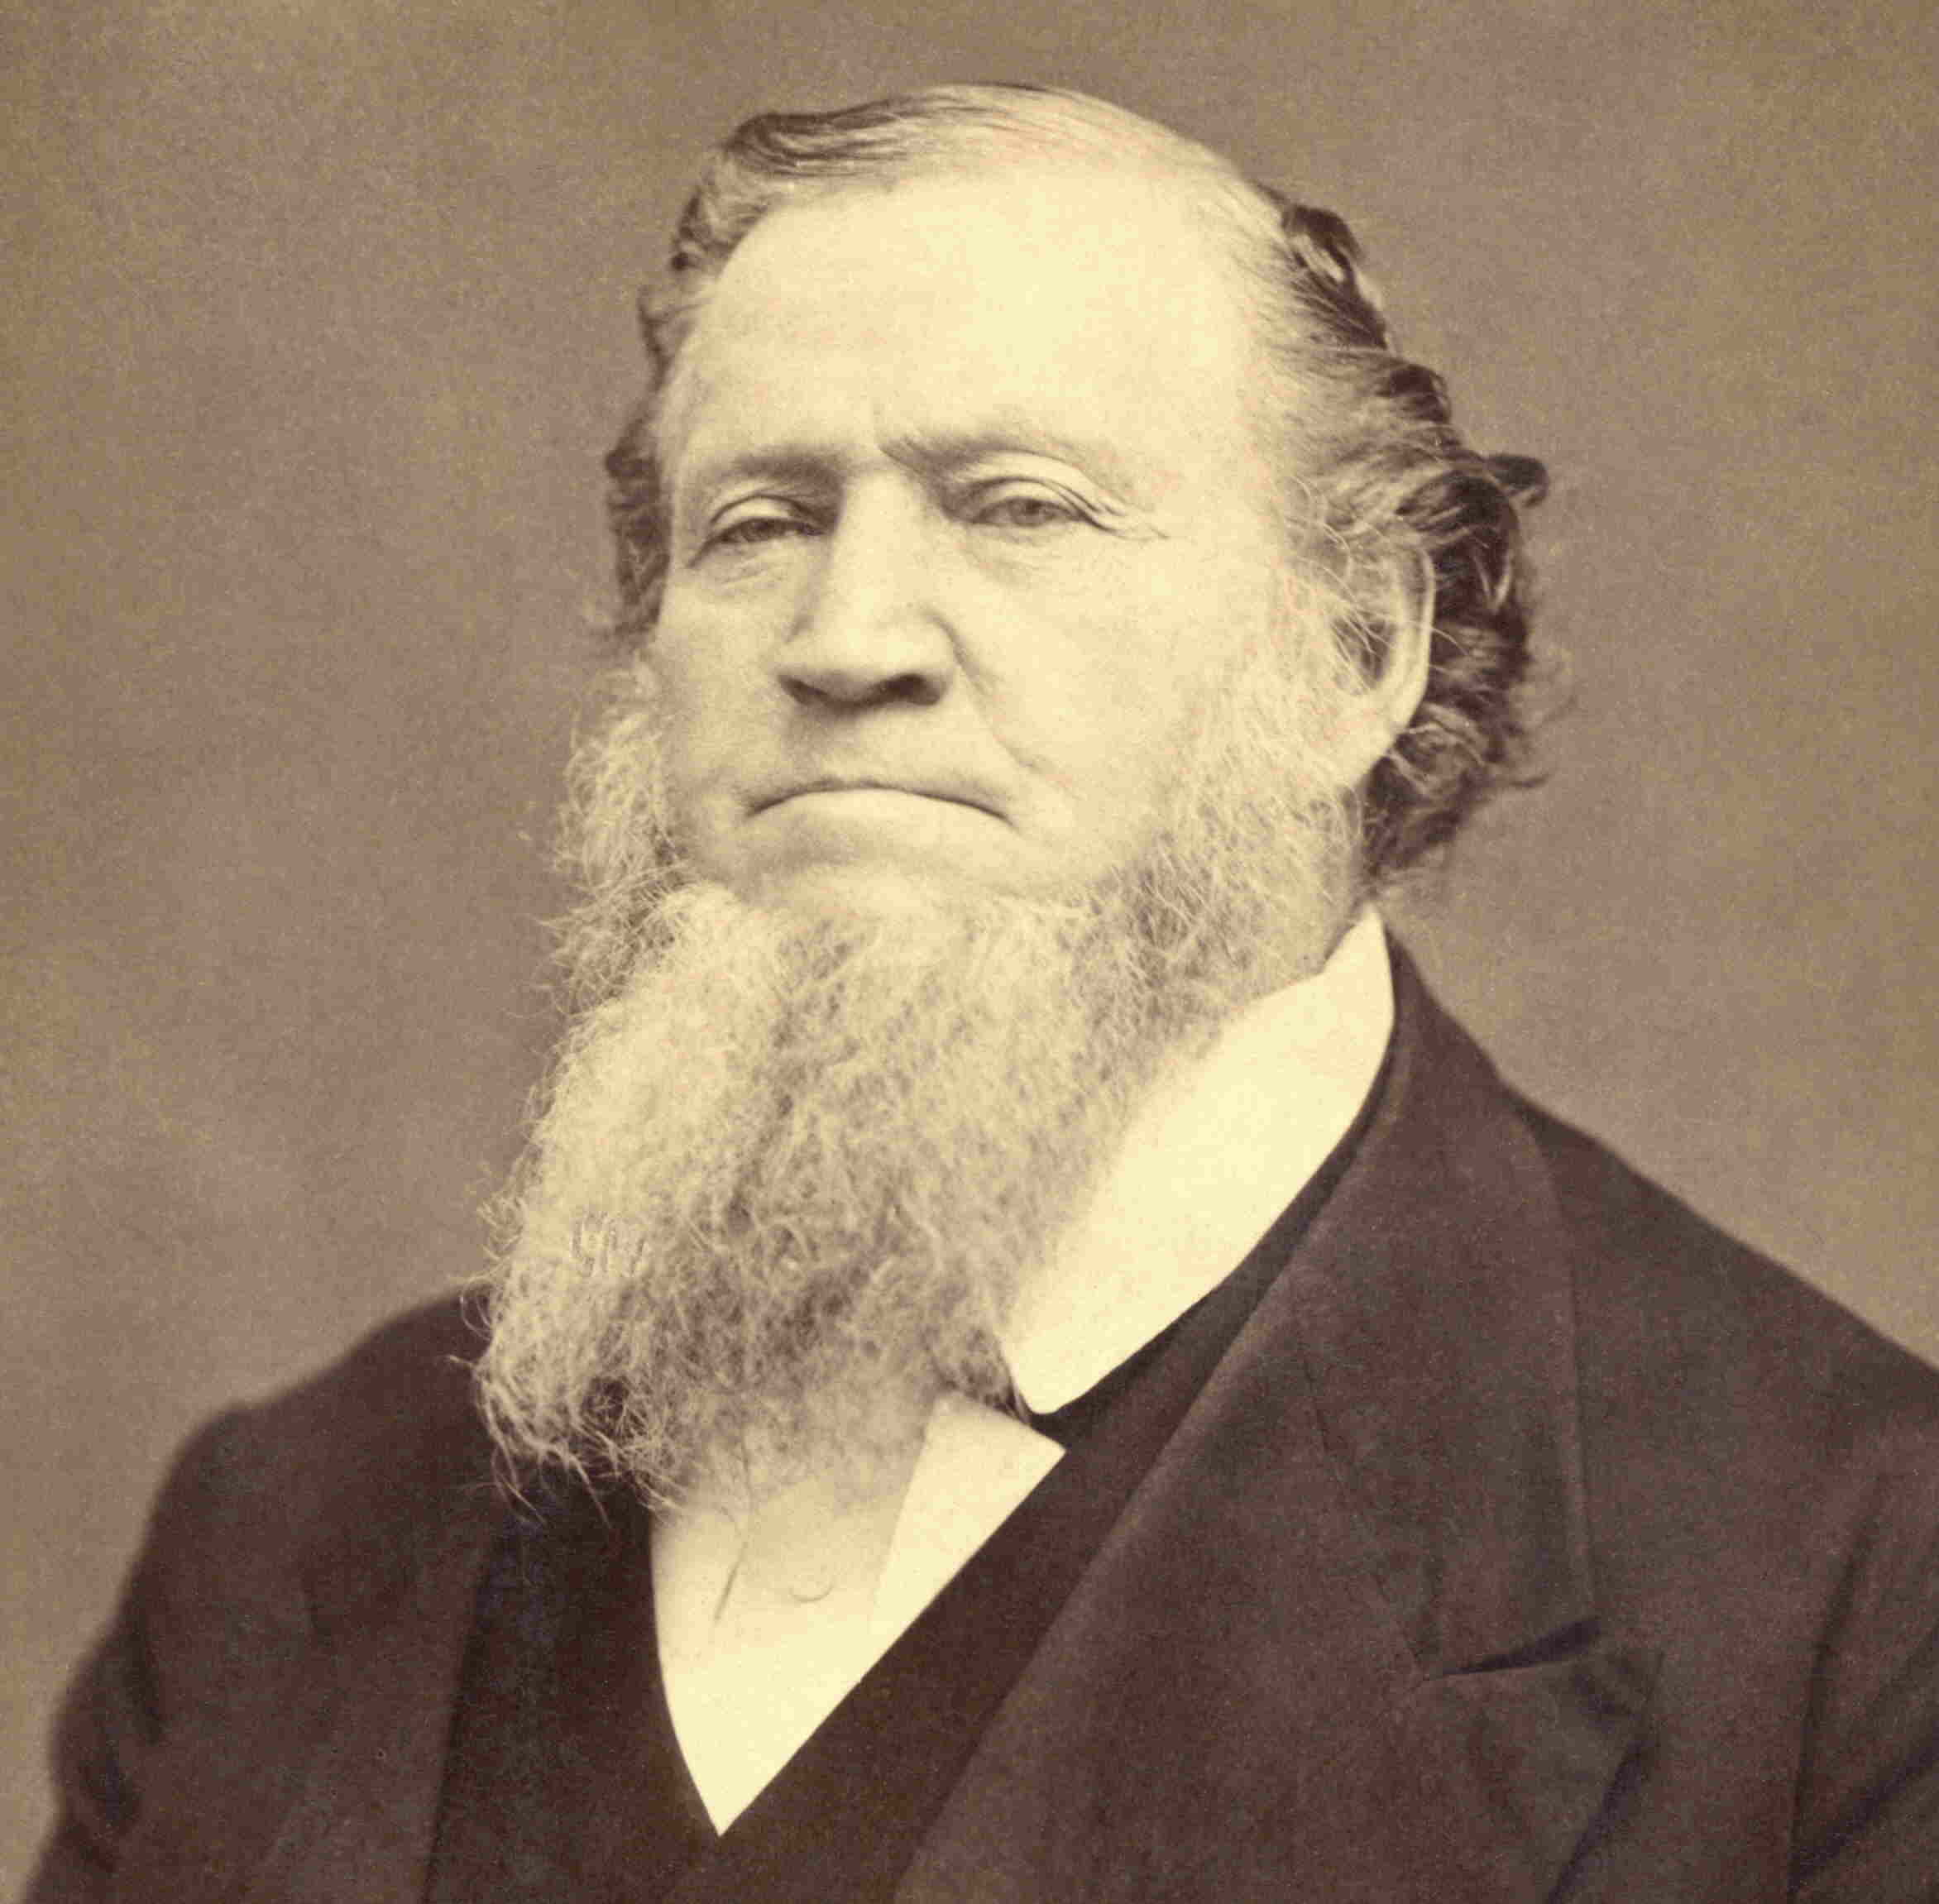
Utah and the Mormons
Brigham Young takes over as leader.
Moves the Mormons to the Great Salt Lake area of Utah, fleeing persecution
Conflicts with federal officials about being incorporated into the US
Utah becomes a state in 1896
Notes:
BYU—Brigham Young University

Slide 12
Essential Question
What factors affected the settlement of California and Utah in the West?
Notes:
1849 gold rush causes rapid growth in population and economic activity
Need for more effective government
Writing of a state constitution
California becomes a state in 1850
Utah settled by the Mormons and territory gained by U.S. after the war with Mexico

