Slide 1
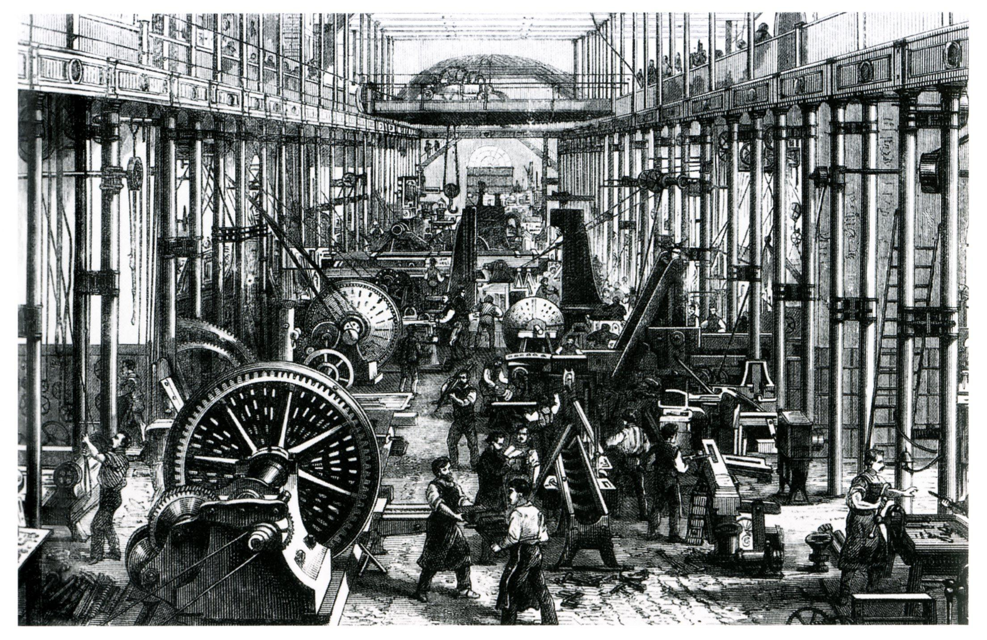
Chapter 10
Growth & Expansion
1790-1825
The American Journey Pages 302-327

Slide 2
Section 3
Unity and Sectionalism
The American Journey Pages 320-327

Slide 3
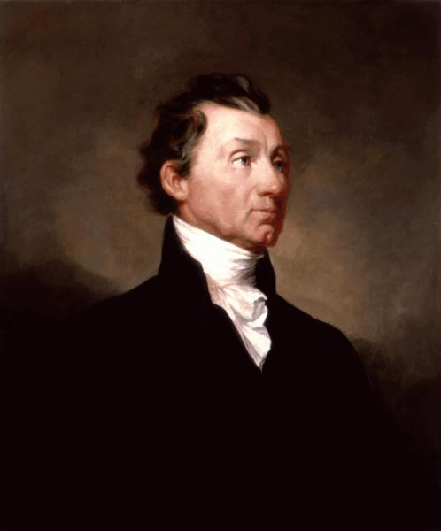
The Era of Good Feelings
1816
James Monroe easily wins presidency & reelection 4 years later
Lots of nationalism unites the country
Called the Era of Good Feelings
Notes:
Main Idea: After the War of 1812, a new spirit of nationalism spread throughout the United States.
Hence the term “Jefferson Era”. That’s going to be 24 straight years of Republican control of the presidency.

Slide 4
Sectionalism & the American System
Sectionalism:
Loyalty to a region more than to the nation
Mostly becomes a north/south thing
What did they disagree about?
Slavery
Tariffs (taxes on imports to protect US businesses)
A national bank
Internal improvements (like roads and canals)
Notes:
Main Idea: Regional differences brought an end to the Era of Good Feelings

Slide 5
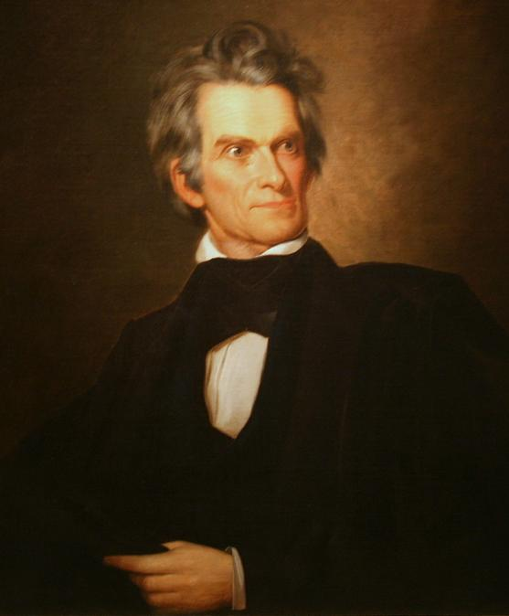
Three Guys to Keep Our Eye On
John C. Calhoun
South Carolina
State sovereignty:
States have the right to govern themselves
Strong opponent of national programs
Believed states could nullify federal laws

Slide 6
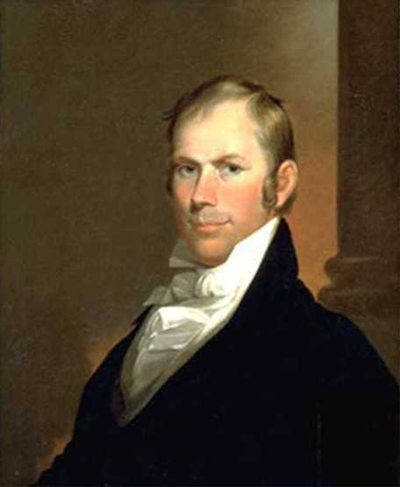
Three Guys to Keep Our Eye On
Henry Clay
Kentucky
1811 Speaker of the House of Representatives
Known as the Great Compromiser

Slide 7
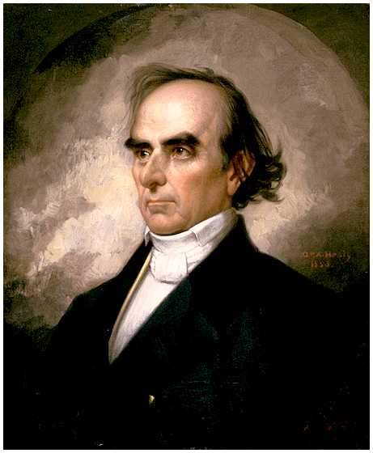
Three Guys to Keep Our Eye On
Daniel Webster
Massachusetts
Argued against states being able to declare laws invalid (nullified).
Known as the greatest orator of his day
The Devil and Daniel Webster

Slide 8
Peace with England and Spain
1818
Northern boundary of the US is set at the 49th parallel
1819
Adams-Onís Treaty
United States gains all of Florida from Spain

Slide 9
The Monroe Doctrine--1823
European plans to help Spain regain colonies in the Americas
Monroe Doctrine
US will not interfere with current European colonies
Going forward, North and South America, “are henceforth not to be considered as subjects for colonization by any European powers.”
Notes:
The Monroe Doctrine was actually penned by his Secretary of State John Quincy Adams

